Slide 1
Sorting of Arrays.
Name: Hassan Farooq Ahmad
Class: BSCS (Section : A )
Subject: Programming Fundamentals
Teacher: Mr. Irfan

Slide 2
Sorting of Array
Sorting in C++ is a concept in which the elements of an array are rearranged in a logical order. This order can be from lowest to highest or highest to lowest. Sorting an unsorted array helps to solve many problems such as searching for the minimum or maximum element, etc.
The most common types of sorting in data structure are insertion sort, selection sort, bubble sort, quick sort, heap sort, and merge sort.
Steps to sort the elements:
If it is the first element, it is already sorted.
Pick the next element.
Compare with all the elements in sorted sub-list.
Then sort the elements

Slide 3
Methods of array Sorting:
There are so many methods to sort the arrays but I will explain you some sorting methods to understand the real concept of array sorting. The methods are given below:
Selection Sort
Bubble Sort
Insertion Sort
Quick Sort

Slide 4
Selection & Bubble sort:
Selection Sort is a simple sorting algorithm that repeatedly finds the smallest element and places it at its correct sorted position. In DSA, Best Case Complexity occurs when there is no need for sorting, i.e., the array has already been sorted. The time complexity of selection sort in worst or average is almost high.
Bubble Sort is the simplest sorting method that works by repeatedly swapping the adjacent elements if they are in the wrong order. This algorithm is not suitable for large data sets as its average and worst-case time complexity is quite high.

Slide 5
Insertion & Quick Sort
Insertion sort is a sorting method that works by shifting each element in the array one at a time. It iterates through the input elements, expanding the sorted array each time by comparing the current element to the sorted array's greatest value. In this method, we have to insert the new element in array to sort. Insertion sort has better time complexity as selection in worst case.
Quick sort algorithm starts by picking a pivot element and then subdivides the array. It then puts the smaller elements on the left side of the pivot and the larger ones on the right side. The partition of arrays continues until each array is left with a single element. Quick sort has better time complexity than all methods in worst case.

Slide 6
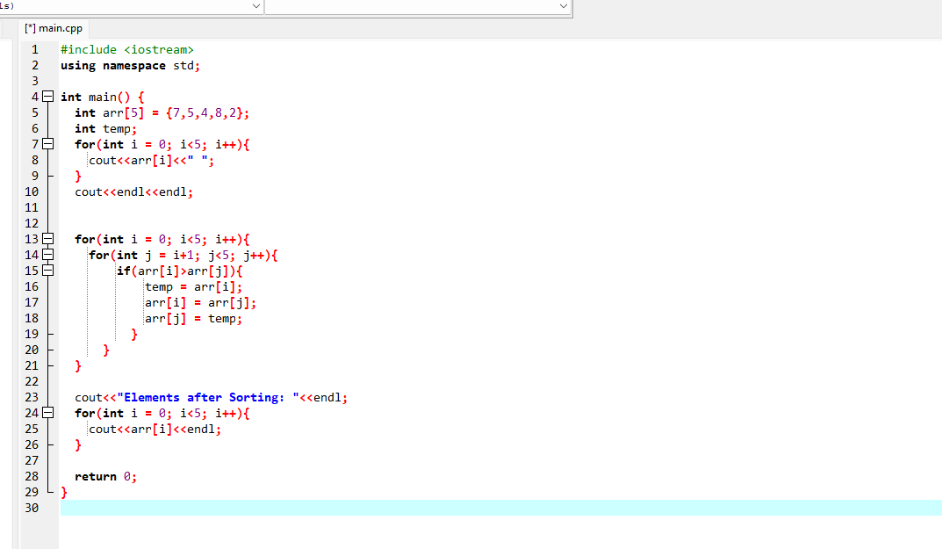
Selection sort program

Slide 7
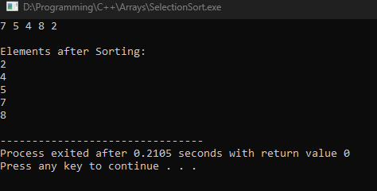
Selection sort program output

Slide 8
















Program Working

Slide 9


















Program Working

Slide 10
















Program Working
3rd iteration :

Slide 11
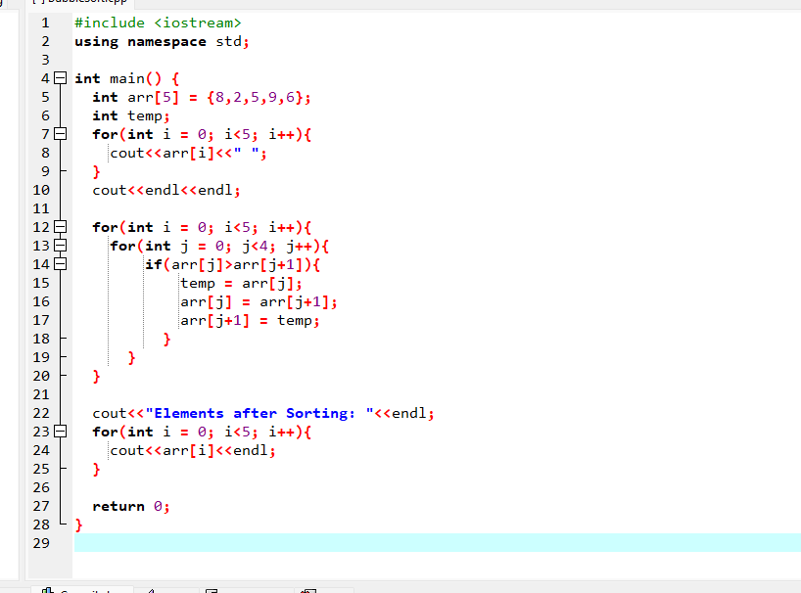
Bubble sort program

Slide 12
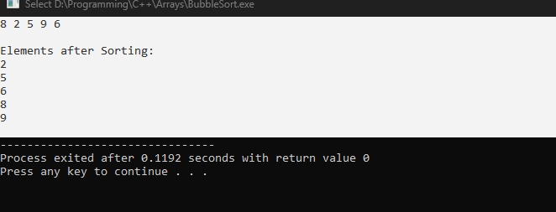
Program output:

Slide 13













Program working
1st Iteration of outer loop:

Slide 14



















Program working
Remaining Iterations:

